Slide 1
Virtual Open House
Aging and Retirement Research
Steven Siegel, Senior Practice Research Actuary
February | 2022

Slide 2
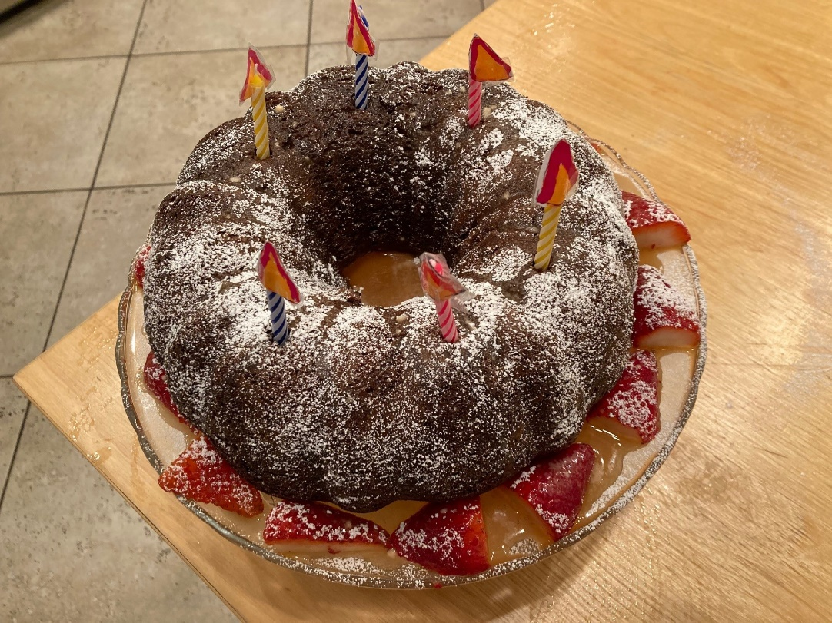
WELCOME TO OUR OPEN HOUSE!
I knew you were coming…so I baked a virtual cake

Slide 3

Aging and Retirement Program History/Mission
Launched in 2018 - First of the 5 Strategic Research Programs
Functions as Umbrella over all Aging and Retirement research
Brings together:
  Post-Retirement Needs and Risks Research
  Retirement Section Research
  Long-Term Care Research
  Retirement Experience Studies
  Support of Living to 100 Conference
  Other related research efforts
Mission
  Explores societal impact of aging populations and solutions for mitigating risks
Governance
  Steering Committee of Actuaries and Non-Actuaries oversees all Program activities
3

Slide 4

Multidisciplinary Focus
Roots: Over 20 years in Post Retirement Needs and Risks Research
Partners: Within and with Non-Actuarial Organizations
Multidisciplinary Experts: Participate in program activities
Topics: Ongoing scanning for a wide array of topics
Reports and consumer guides: Address timely issues and promoted beyond Actuarial Community
SOA Partner (Non-Actuary) Awards: John Cutler, Sara Rix
Extensive Email Distribution (Listserv) of 300+ Actuaries/Non-Actuaries for Conversations, Outreach, Networking
4

Slide 5

Partnering
Actively Seek Partners
Internal SOA and Actuarial Partners
  Strategic Research Programs- Climate Change and Retirement, etc.
  Sections – Pension Risk Transfer with Investment Section, etc.
  Other Actuarial Organizations - CIA
External Partners (examples)
  LIMRA – Retirement Fraud
  WISER – Retirement Risks for Women
  Sponsors
  Applications to Robert Wood Johnson, Retirement Research Foundation
5

Slide 6

Environmental Scanning
Brainstorming of Emerging Events or Topics
  Wide-Ranging Example: COVID and Retirement
  Another Recent Example: Climate Change and Retirement
  Initially prompted by articles (Marketwatch, etc.)
  RFP/Call for Essays in partnership with Cat and Climate Program
Innovative Environmental Scanning Approach
  Identify Megatrends and Paradigm shifts in Retirement
  Engaged Team of Futurists specializing in Retirement
  Team brings deep experience in broad long-range thinking
Goal --Stimulate long term horizon and broad thinking by actuaries
  and other experts
Direct output - Priorities for future research and new conversations
6

Slide 7

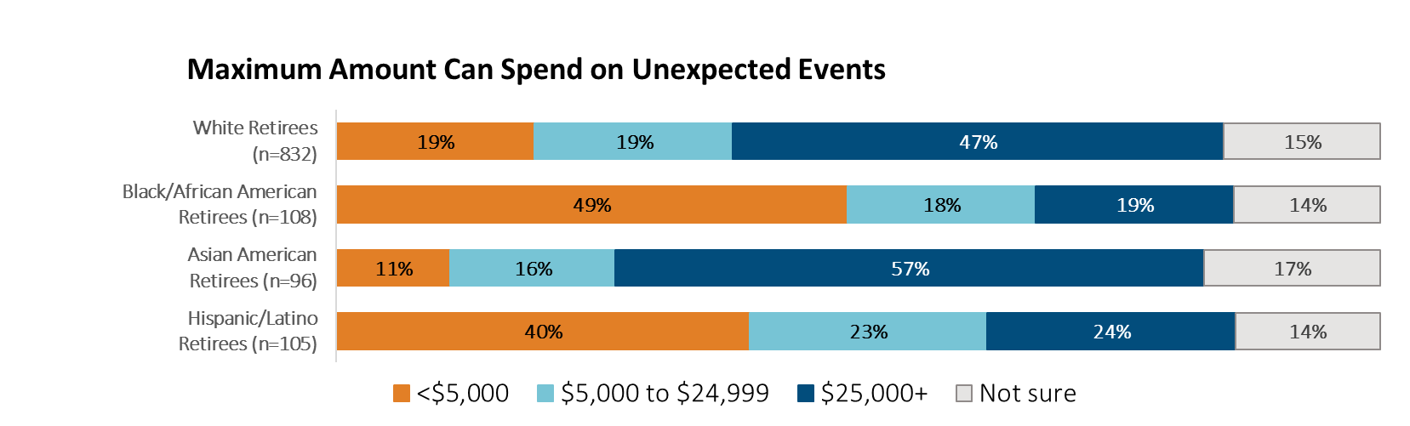
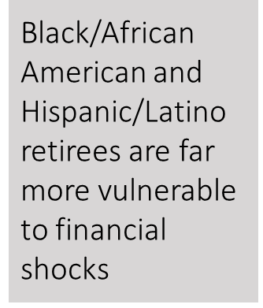
Diversity, Equity and Inclusion Priority
Diversity, Equity and Inclusion Priority
Motivation: Research Links to SOA’s Overall DEI Initiative
Expand Ongoing Work: New Survey Questions to Periodic Surveys (Retirement Risk, Across Generations)
New Efforts: Essay collections Addressing Race/Ethnicity and LGBTQ+ Issues
Partners: SAGAA (Sexuality and Gender Alliance for Actuaries) and DEI Strategic Research Program
Consistent Approach: Evaluate all projects for potential DEI exploration
Example: Finding from 2021 Risk Survey
7

Slide 8
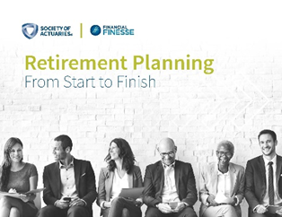



Consumer Focused Research and Guides
Consumer Based Research
  Ongoing Surveys of Consumers – Retirement Risk Survey since 2001, Generations since 2018
  Consumer Focus Groups at Different Retirement Stages
  Interviews
Guides for Consumers
  Written in Consumer-Friendly Language
  Series of 11 Brief Reports on Retirement Decisions
  Series on Retirement Literacy
  Late in Life Decisions Guide
  Longevity Infographics
  Managing Post-Retirement Risks Strategies (Risk Chart)
  New Project Starting on Solo Aging
8

Slide 9
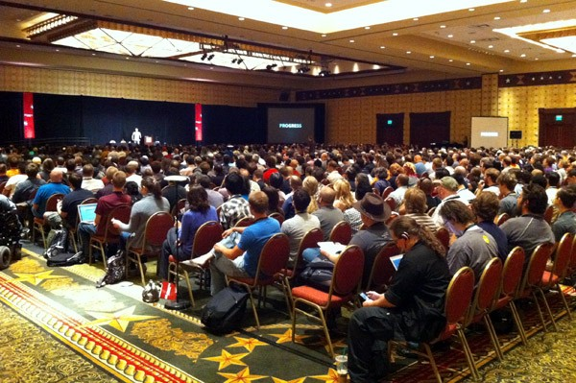
Professional Development
Recent Sessions at the 2022 SOA Impact
and Living to 100 Conference
Participate in:
Non-SOA industry conferences
Actuarial clubs (Middle Atlantic Actuarial Club, etc.)
Webcasts (Impact of Financial Well-Being last week, upcoming)
9

Slide 10
Communication Strategies
Traditional Means – Reports, Software Tools, etc.
Videos/Podcasts
Fast Facts
Articles – Section Newsletters, Trade Publications
Announcements – Email Listserv with over 300 professionals
Frequent Media Citations
Exploring New Ways to Reach Consumers
Check out: https://www.soa.org/research/topics/aging-ret-topic-landing/
Image from: New York Times, 4/24/2022
10

Slide 11
Special thanks to our Steering Committee!
Ruth Schau, Chair Lisa Ullman, Vice Chair Carol Bogosian John Cutler Justin Frazier Tim Geddes Jim Glickman Joseph Goodman Sam Gutterman Howard Iams Justin Frazer Alan Newsome Cindy Levering, Former Chair Larry Pollack Anna Rappaport, Former Chair Sara Rix Andrea Sellars Faisal Siddiqi Jeff Williams Nathan Zahm
11

Slide 12

Your turn….
Questions?
Comments?
Thoughts for new projects?
This Photo by Unknown Author is licensed under CC BY-NC-ND

