Slide 1
Individual Life Experience Update Session 55
SOA Life and Annuity Symposium
Session 55: Individual Life Mortality
Roland Fawthrop, FSA, MAAA
Tuesday, May 9, 2017

Slide 2
An Overview of the New Individual Life Mortality Study
New experience: 2009 – 2013 Calendar Years
Prior ILEC data will be made available within same file
All study years back to 2002-2003 (previous studies used anniversary-to-anniversary approach)
In data file and the slides that follow, the exposure year refers to the calendar year in which the policy year ends
Standard Ordinary, fully underwritten business
Preferred Class detail
Term products split by level term period
And much more!

Slide 3
2009 – 2013 experience data also includes:
Post-Level Term experience
Nonforfeiture Elections (ET, RPU)
Experience at small face amounts
$1 - $9,999
$10,000 - $24,999

Slide 4
Additional supplementary data
Types
Cause of death
Substandard
Converted policies
Lapses
Collected
Observation year 2012
Review of information collected
Insufficient data for a report
Next data sets
Observation years 2013-2014 collected in 2016
Observation years 2014-2015 collection in 2017

Slide 5
New data sources
2009
NY mandated data
KS voluntary data
Minus 2009 data from companies already included in prior study
2010
NY mandated data
KS voluntary data
2011 – 2013
NY mandated data
KS mandated data

Slide 6
Differences
Data collected in 2013 vs. 2009 (prior study only)
Larger average policy face amounts
Lower A/E claims experience
Much larger experience dataset
4.4 million claims over 11 observation years
Type | Percent increase
No. of companies (37 -> 88) | +138%
No. of claims | +53%
Claim amounts | +186%
Exposure policy years | +66%
Exposure amount years | +142%

Slide 7
Mortality experience – All face amounts By face amount (Expected = 2015 VBT)
Observation Year | SOA collected (Previously available) | Statistical Agent collected (new) | Combined
Total | 110% | 96% | 101%
2003 | 119% |  | 119%
2004 | 115% |  | 115%
2005 | 110% |  | 110%
2006 | 110% |  | 110%
2007 | 108% |  | 108%
2008 | 108% |  | 108%
2009 | 104% | 98% | 101%
2010 |  | 98% | 98%
2011 |  | 98% | 98%
2012 |  | 96% | 96%
2013 |  | 94% | 94%

Slide 8
Mortality experience – Face amounts $100K+ By face amount (Expected = 2015 VBT)
Observation Year | SOA collected (Previously available) | Statistical Agent collected (new) | Combined
Total | 105% | 92% | 96%
2003 | 114% |  | 114%
2004 | 110% |  | 110%
2005 | 106% |  | 106%
2006 | 105% |  | 105%
2007 | 104% |  | 104%
2008 | 103% |  | 103%
2009 | 99% | 94% | 97%
2010 |  | 94% | 94%
2011 |  | 94% | 94%
2012 |  | 92% | 92%
2013 |  | 89% | 89%

Slide 9
Exposures are shifting toward higher face amounts…
Observation | Face Amount
Year | 25k-49K | 50K-99K | 100K-249K | 250K-499K | 500K-999K | 1M+
2003 | 16.4% | 25.2% | 36.9% | 12.9% | 5.7% | 2.9%
2004 | 15.3% | 24.3% | 36.7% | 13.8% | 6.6% | 3.3%
2005 | 15.1% | 22.9% | 35.2% | 14.8% | 7.6% | 4.3%
2006 | 15.2% | 24.0% | 35.0% | 14.7% | 7.4% | 3.8%
2007 | 14.9% | 23.7% | 34.3% | 14.9% | 8.0% | 4.2%
2008 | 15.0% | 22.9% | 32.5% | 15.8% | 9.0% | 4.8%
2009 | 13.2% | 20.3% | 32.0% | 18.1% | 10.6% | 5.8%
2010 | 14.0% | 19.5% | 31.1% | 18.1% | 10.7% | 6.5%
2011 | 12.1% | 17.0% | 31.8% | 19.8% | 12.0% | 7.3%
2012 | 11.6% | 15.6% | 31.1% | 20.2% | 13.1% | 8.3%
2013 | 11.7% | 16.6% | 31.2% | 20.2% | 12.6% | 7.8%
%’s are by Policy Count
All durations

Slide 10
… and shift into ultimate durations
Observation | Duration
Year | 1-5 | 6-10 | 11-15 | 16-20 | 21-25 | 26+
2003 | 37.4% | 23.1% | 20.2% | 14.9% | 2.7% | 1.6%
2004 | 37.2% | 23.2% | 18.9% | 15.1% | 3.9% | 1.7%
2005 | 33.9% | 23.4% | 17.8% | 16.2% | 6.3% | 2.3%
2006 | 32.9% | 22.6% | 17.0% | 16.4% | 8.4% | 2.7%
2007 | 31.2% | 23.0% | 16.3% | 16.2% | 10.4% | 2.9%
2008 | 31.5% | 23.4% | 14.7% | 14.5% | 11.8% | 4.0%
2009 | 31.2% | 26.4% | 14.2% | 12.0% | 10.7% | 5.5%
2010 | 27.1% | 23.2% | 15.7% | 12.6% | 11.8% | 9.7%
2011 | 28.9% | 24.8% | 16.7% | 10.8% | 9.9% | 9.0%
2012 | 26.8% | 24.1% | 17.5% | 10.6% | 9.9% | 11.2%
2013 | 27.7% | 23.1% | 17.8% | 10.1% | 9.2% | 12.0%
%’s are by Policy Count
All durations

Slide 11
Average Face Amount – by Duration
Observation | Duration
Year | 1-5 | 6-10 | 11-15 | 16-20 | 21-25 | 26+
2003 | 271,401 | 169,145 | 108,149 | 77,283 | 56,598 | 43,922
2004 | 295,802 | 185,741 | 113,717 | 81,241 | 60,250 | 44,821
2005 | 335,591 | 229,267 | 132,295 | 93,594 | 69,390 | 46,651
2006 | 330,246 | 215,337 | 126,503 | 95,816 | 69,853 | 48,181
2007 | 358,141 | 232,497 | 134,670 | 99,612 | 72,269 | 50,138
2008 | 375,346 | 254,975 | 148,044 | 105,677 | 77,846 | 51,350
2009 | 388,308 | 301,900 | 185,501 | 117,000 | 87,191 | 62,751
2010 | 436,266 | 348,869 | 217,170 | 129,284 | 99,189 | 72,974
2011 | 444,218 | 379,480 | 247,227 | 135,869 | 99,556 | 72,599
2012 | 487,285 | 425,849 | 285,755 | 154,042 | 108,143 | 77,151
2013 | 436,123 | 421,538 | 292,926 | 163,614 | 109,918 | 78,913

Slide 12
Mix of business – by Gender/Class
Observation | Gender/Tobacco Class
Year | Male NT | Male TB | Female NT | Female TB
2003 | 49% | 8% | 35% | 4%
2004 | 49% | 7% | 36% | 4%
2005 | 50% | 7% | 35% | 4%
2006 | 49% | 8% | 36% | 5%
2007 | 49% | 7% | 36% | 4%
2008 | 50% | 6% | 38% | 3%
2009 | 50% | 5% | 38% | 3%
2010 | 49% | 6% | 37% | 3%
2011 | 49% | 5% | 39% | 3%
2012 | 50% | 5% | 39% | 3%
2013 | 49% | 5% | 39% | 3%
%’s are by Policy Count
All durations
Approx. 4% are unknown tobacco/smoker class

Slide 13
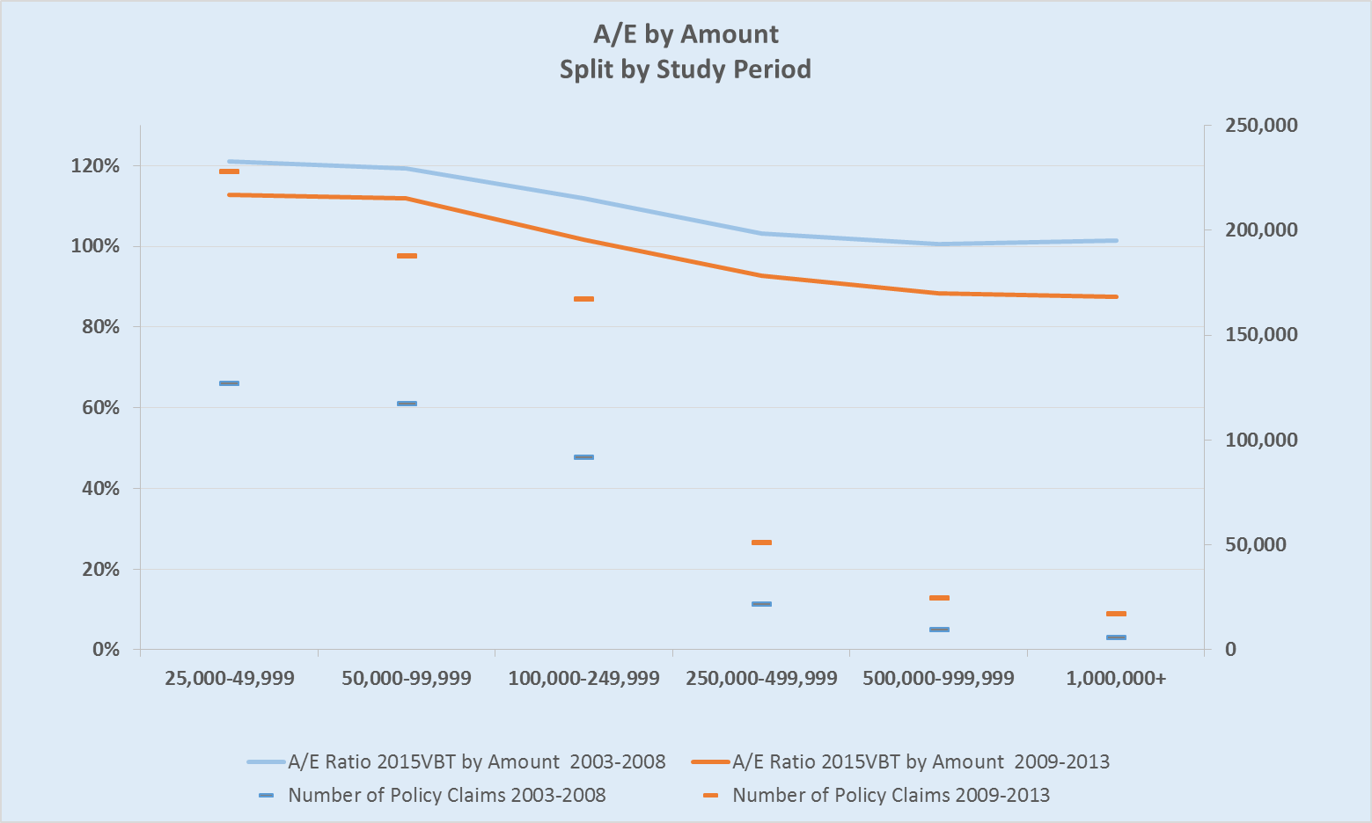
Comparison of new data to prior:

Slide 14
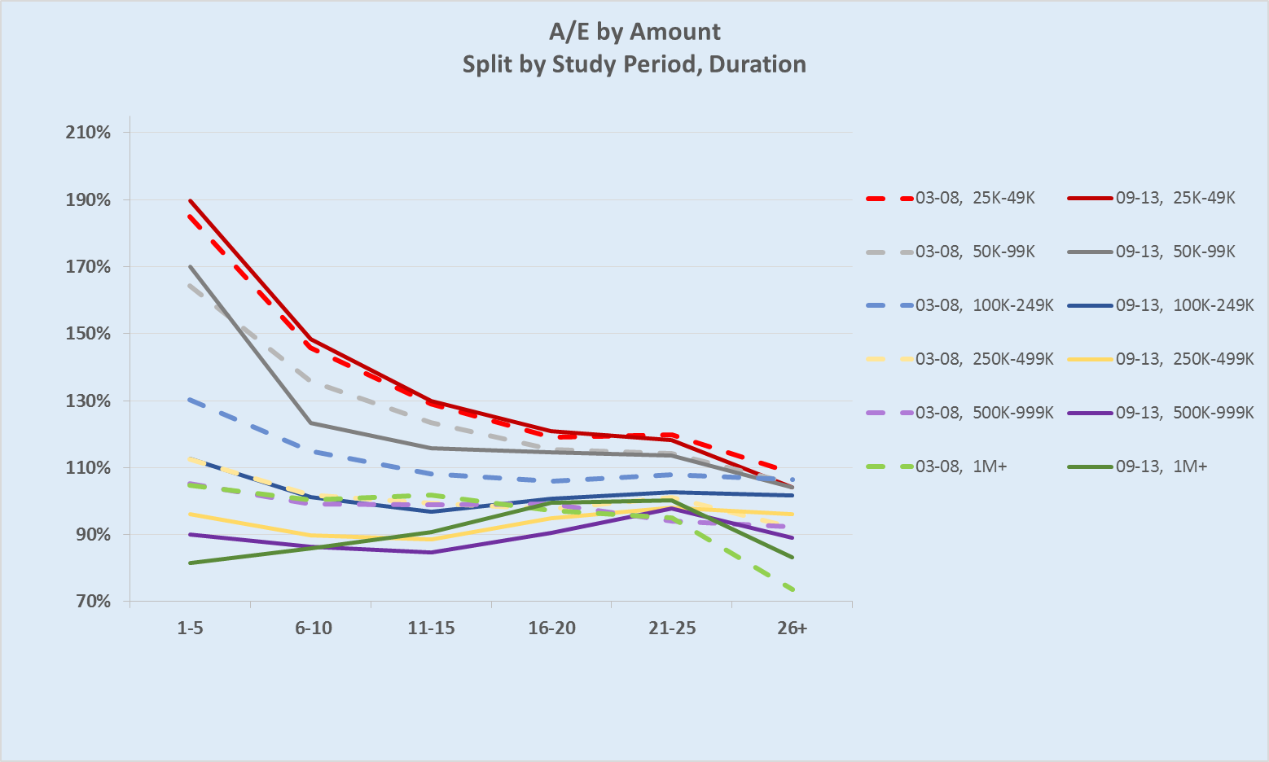
Refining further, by duration:

Slide 15
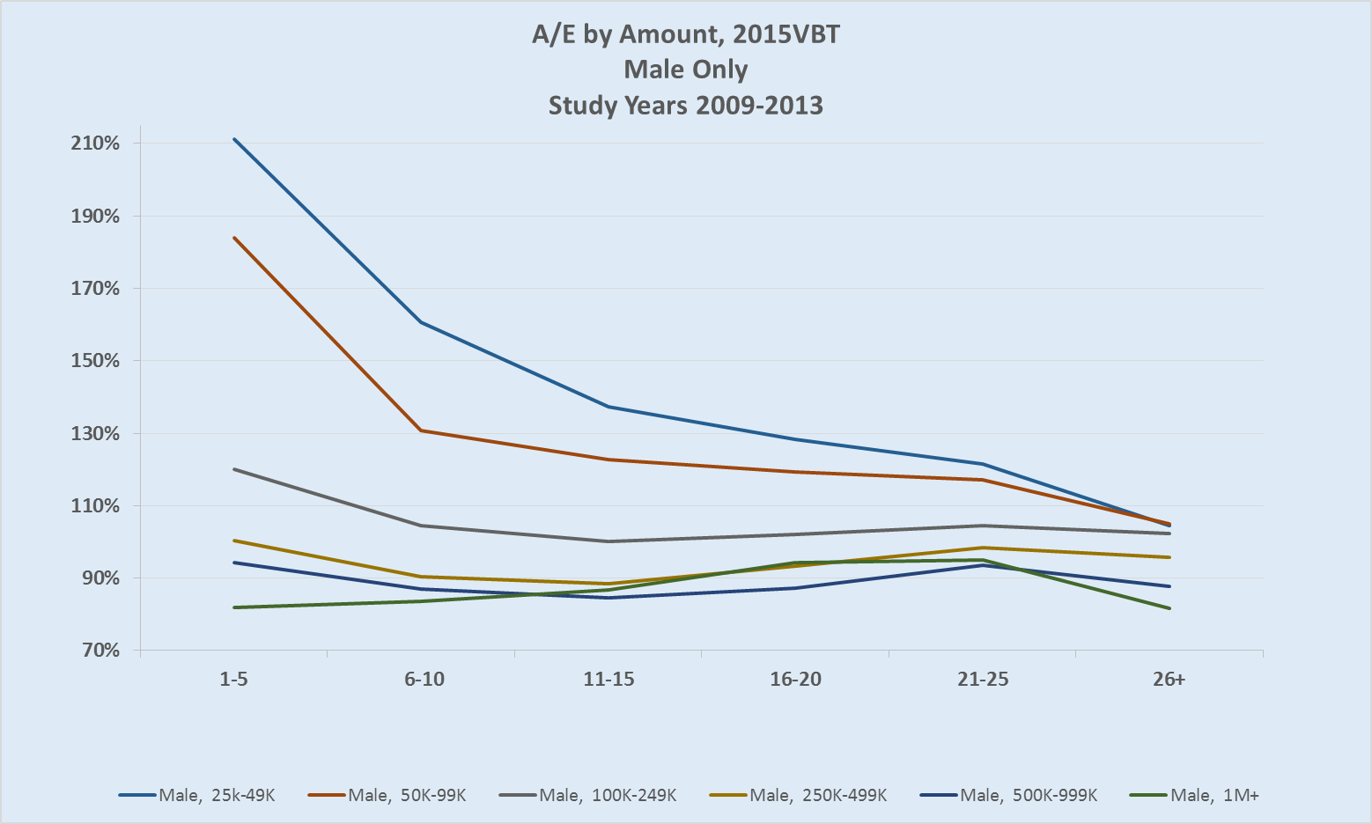
Differences in Slope exist for Males…

Slide 16
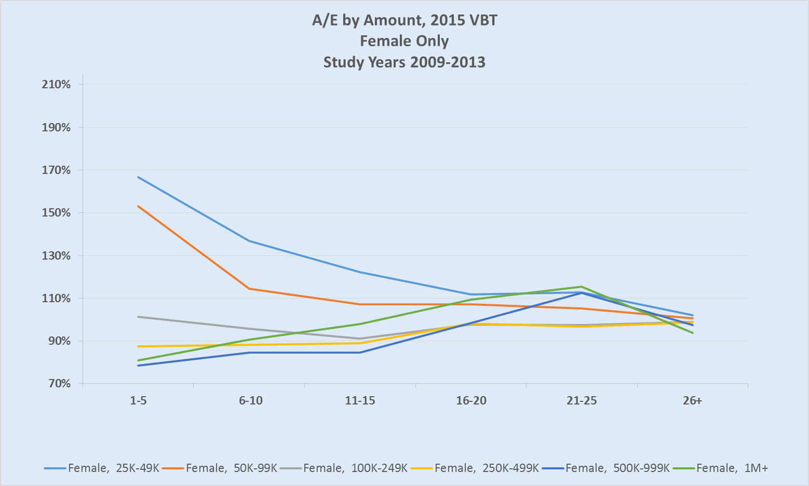
… and Females

Slide 17
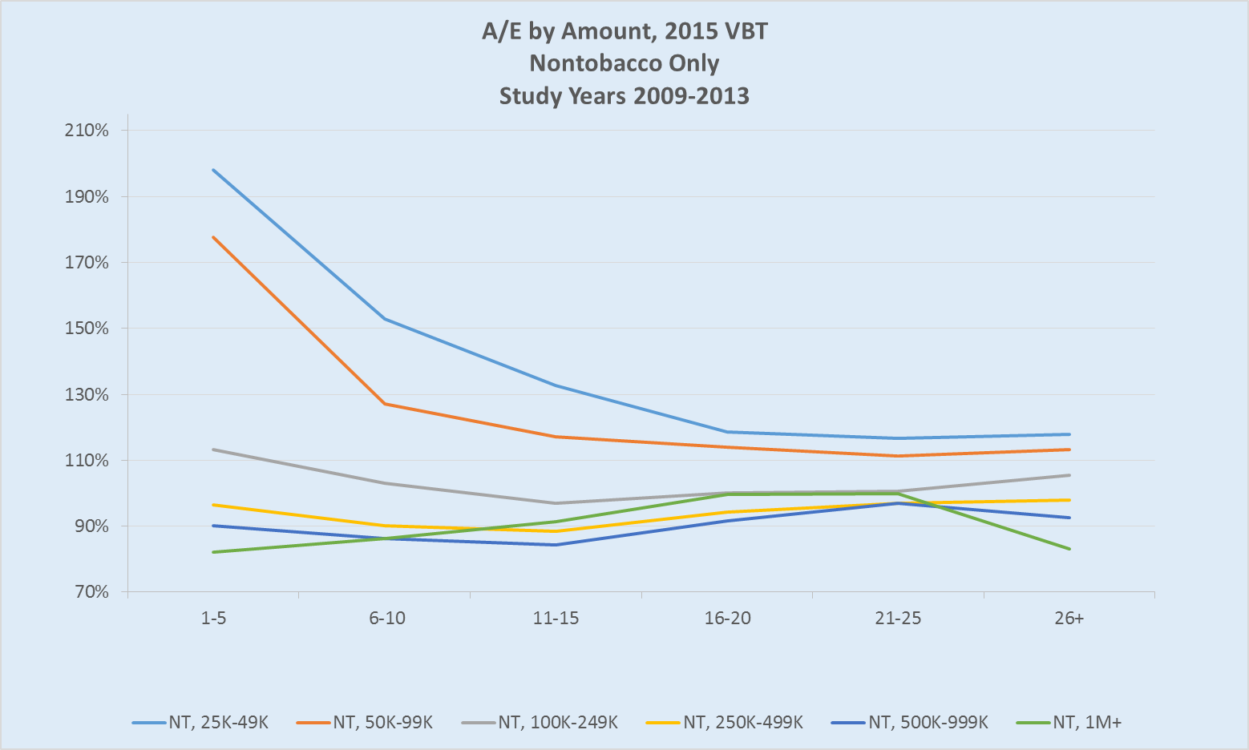
A look at slope for Nontobacco…

Slide 18
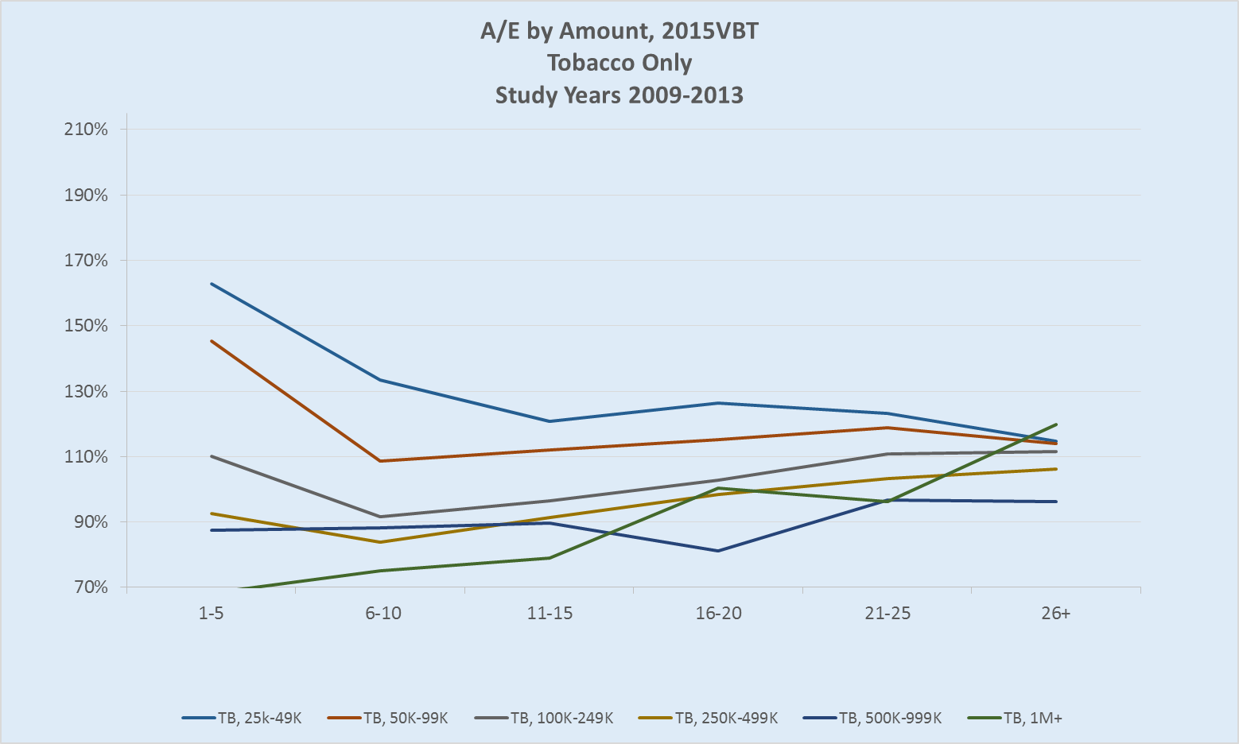
… and Tobacco

Slide 19
Differences by Plan?
Insurance Plan | 25,000-49,999 | 50,000-99,999 | 100,000-249,999 | 250,000-499,999 | 500,000-999,999 | 1,000,000+ | Grand Total
Perm | 115% | 104% | 91% | 87% | 84% | 86% | 92%
Term | 176% | 145% | 105% | 90% | 84% | 82% | 90%
UL | 131% | 123% | 109% | 105% | 102% | 93% | 103%
ULSG | 123% | 113% | 97% | 94% | 94% | 87% | 90%
VL | 120% | 112% | 100% | 96% | 102% | 107% | 104%
VLSG | 122% | 115% | 102% | 96% | 94% | 113% | 105%
Total | 126% | 118% | 102% | 93% | 89% | 88% | 94%
A/E by Amount, 2015VBT
Durations 1-25 Only
Study Years 2009-2013

Slide 20
Preferred Class Experience 2 Nontobacco Class Structure
Class |  | 1-5 | 6-10 | 11-15 | 16-20 | 21-26 | 26+ | Grand Total
1 | Claim Count | 1,322 | 3,857 | 6,296 | 7,278 | 3,540 | 928 | 23,221
 | A/E 2015 | 68.2% | 82.2% | 88.3% | 90.9% | 89.4% | 99.0% | 86.1%
2 | Claim Count | 2,491 | 6,028 | 8,148 | 6,463 | 3,886 | 1,416 | 28,432
 | A/E 2015 | 115.8% | 115.5% | 119.0% | 129.3% | 118.7% | 113.1% | 119.2%
Total | Claim Count | 3,813 | 9,885 | 14,444 | 13,741 | 7,426 | 2,344 | 51,653
 | A/E 2015 | 88.8% | 98.6% | 101.7% | 104.7% | 101.9% | 106.2% | 100.6%
Study Years 2009-2013
Face amounts $100k+
A/E by amount
Note: Classes are numbered from best to residual (best class is 1)

Slide 21
Preferred Class Experience 3 Nontobacco Class Structure
Class |  | 1-5 | 6-10 | 11-15 | 16-20 | 21-26 | 26+ | Grand Total
1 | Claim Count | 1,797 | 3,733 | 3,740 | 380 | 2 | 3 | 9,655
 | A/E 2015 | 64.7% | 69.5% | 74.9% | 72.4% | 6.3% | 21.2% | 70.1%
2 | Claim Count | 2,216 | 5,034 | 3,676 | 454 | 4 | 1 | 11,385
 | A/E 2015 | 74.4% | 77.9% | 87.4% | 90.6% | 6.7% | 1.6% | 79.5%
3 | Claim Count | 5,176 | 9,633 | 4,108 | 274 | 56 | 58 | 19,305
 | A/E 2015 | 105.6% | 104.2% | 108.5% | 93.6% | 39.5% | 24.8% | 104.2%
Total | Claim Count | 9,189 | 18,400 | 11,524 | 1,108 | 62 | 62 | 40,345
 | A/E 2015 | 86.2% | 87.5% | 88.3% | 84.4% | 32.3% | 22.6% | 87.0%
Study Years 2009-2013
Face amounts $100k+
A/E by amount
Note: Classes are numbered from best to residual (best class is 1)

Slide 22
Preferred Class Experience 4 Nontobacco Class Structure
Study Years 2009 – 2013
Face Amounts $100,000+
A/E’s by Amount
Note: Classes are numbered from best to residual (best class is 1)

Slide 23
Considerations when evaluating mortality experience:
“shape” of underlying table used as expected
era during which each durational group was underwritten
Transition from unismoke to SM/NS
Transition from SM/NS to TB/NT
Increased prevalence of preferred class underwriting
Credibility
Impact of using A/E’s weighted by Amount
Understand product designs in the experience

Slide 24
Poll survey Question 1 How do you use the Individual Life Experience Committee Mortality Study results and reports? (Check all that apply)
Educational – learn more about techniques in evaluating mortality results
Benchmarking – compare own company mortality results to industry
Pricing – use with appropriate company-specific adjustments
Don’t use

Slide 25
Poll survey Question 2 Do you use and find the exhibits and/or appendix tables included in the reports useful? (one response only – answer closest to your situation)
Yes: Primary source of analysis
Somewhat: Only use at a high level review, pivot tables are main source for analysis
No: Don’t use
Don’t know

Slide 26
Poll survey Question 3 What type of data files would you prefer? (one response only – answer closest to your situation)
Detailed: As much detail as possible, file size is not an issue
Current: Current pivot table structure is fine
Smaller: File size limited to what MS Excel or Access (or equivalent) can handle
Don’t use: Detail data files are not important to my company

Slide 27
Poll survey Question 4 What future supplemental mortality analysis from ILEC data would you be very interested in seeing? (Check all that apply)
Cause of death
Post level term
Substandard: Table rated/ flat extra
Term conversion

Slide 28
Poll survey Question 5 Would you like to see more Predictive Modeling in ILEC experience studies? (one response only – answer closest to your situation)
Yes
No
Don’t care: Not sure what it would mean in practice

