Slide 1
UCS Calculator – 2014 Version
User Instructions
January 30, 2015
Dieter Gaubatz
Chair – Underwriting Criteria Team

Slide 2
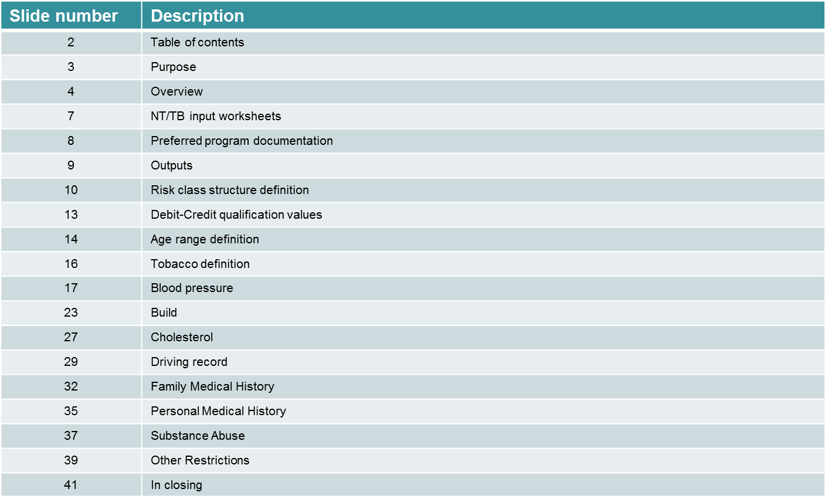
Table of Contents

Slide 3
Purpose
Instructions for using 2014 Underwriting Criteria Score (UCS) calculator
All references to worksheets and cells are for an excel spreadsheet
  “UCS Calculator 2015-01-30.zip”
Algorithm is a prototype focusing on the calculation principles and the feasibility of the calculation
Documentation of the principles, formulas and assumption parameters of algorithm are in scope here, and will be provided separately
The program has insufficient functionality for optimal user friendliness
SOA will produce a more efficient version in 2015

Slide 4
Overview
All worksheets are protected
  Ensures no stray inputs are inserted into incorrect cells
  No password is needed to unprotect a worksheet
Cell locking
  Only cells used to define parameters of “Preferred Program” are unlocked for input
  These are only cells which can be changed when a worksheet is protected
Cell hiding
  Cells in the input worksheets are hidden and unhidden based on the inputted program definitions
  Cell value contents of hidden cells are not deleted. However, they are ignored in all calculations
Edits
  There are no edits to ensure that all inputs are consistent

Slide 5
Overview
Choosing a Specific “NT” and “TB” Worksheet Set
Program allows the saving of up to 8 separate preferred program definitions
  Eight separate NT/TB input worksheet sets - named “Input-{NT/TB} xxx”
Choosing preferred program set for input / calculation
  Worksheet “1. Input Calculator”
    Set is chosen in cell C3
    Cells E3:E4 provide the NT/TB worksheet names of the chosen set
      “NT” and “TB” worksheets are linked; they work together
    Cells A8:Y8 show the calculation results based on the definitions of the worksheets shown in E3:E4
    Cell values in B8:Y8 can be manually copied into any of the rows in cells B14:Y21, to allow for result comparisons of various programs

Slide 6
Overview
Worksheets Defining a Specific Preferred Program Structure
Only the program (one set of NT / TB inputs) chosen in cell C3 is calculated
All {NT, TB} combo worksheets not chosen (and therefore not being calculated) have an orange background color
No other worksheets in the file need input
  All locked (without a password)

Slide 7
NT/TB Input Worksheets
Structure of “NT and “TB” input worksheets are the same
Same instructions apply to both, unless specifically stated otherwise
Insert non-tobacco criteria into “NT” worksheet
Insert tobacco criteria into “TB” worksheet
Up to 6 non-tobacco and 6 tobacco classes can be included in any one program
DO NOT copy/paste inputs from one section to another or between worksheets
  This will impact the “conditional formatting” formulas built into the worksheet
    Used to hide and unhide cells as needed for input based on the program specifics

Slide 8
NT/TB Input Worksheets
Preferred Program Documentation: Cells C2:C5
Title / description of the program
No impact on calculation
Insert desired information into the “NT” worksheet, this information will also show up automatically in the “TB” worksheet

Slide 9
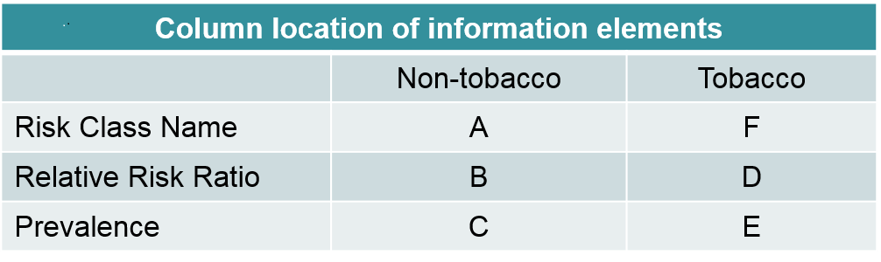
NT/TB Input Worksheets
Outputs: Cells A7:F15
Relative Risk Ratio (RRR) and prevalence values determined from calculation
No inputs in this section
Data column location
Relative Risk Ratio – Expected actual/expected ratio of the specific risk class as a percentage of normal overall portfolio. Overall program is 100%, unless modified by program “non industry standard” min/max values
Prevalence – Percentage of total business expected to qualify for the specific risk class, based on an industry average distribution of risks (probably different distribution than that of the program of any particular company)

Slide 10
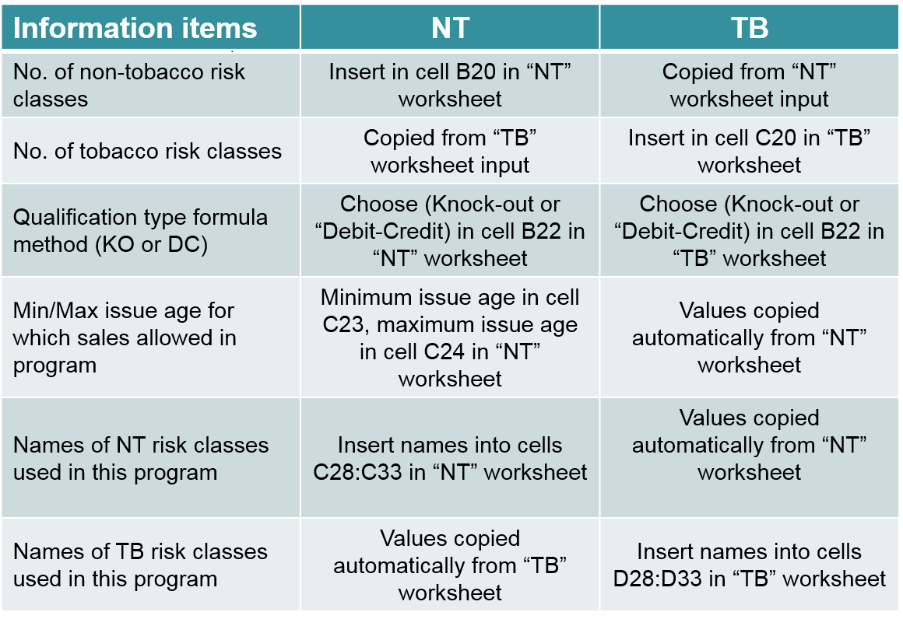
NT/TB Input Worksheets
Risk Class Structure Definition - Cells A18:D33

Slide 11
NT/TB Input Worksheets
Risk Class Structure Definition #1
No. of non-tobacco and tobacco risk classes
  Include the standard/residual class in this count
Internal names of non-tobacco and tobacco risk classes used in this program
  List class names in order of expected mortality, with lowest mortality at the top and standard/residual class at the bottom
  These manually inputted names will be used to define the risk classes in the remainder of the program
  Ensure that the number of risk class names is the same as the number of risk classes indicated in cells B20 and C20

Slide 12
NT/TB Input Worksheets
Risk Class Structure Definition #2
Qualification type formula method
  The type chosen is for the overall program, each preferred
  If “Knock-out” is chosen
    “Knock-out” must be chosen as the formula type for all individual risk criteria sections
    Cells A35:F43 are grayed out
  If “Debit-Credit” is chosen
    “Knock-out” or “Debit-Credit” can be chosen as the formula method for each of the risk class criteria sections independently
    Cells A35:F43 must be filled out
  Combo DC/KO programs are defined as DC, and are acceptable.
    Note: Any inputted values still left in a section which is grayed out will be ignored in the calculation. This is the case for all grayed out sections in this program, not only this one.

Slide 13
NT/TB Input Worksheets
Debit-Credit Qualification Values - Cells A35:D43
This section is needed only if the program structure uses a “debit-credit” approach
  If not D/C, the whole area is grayed out, not visible, and will be ignored
The number of DC points needed to qualify for a specific risk class are inputted in columns C and D
  The value in column C is the minimum number of points that would result in a risk being included in the particular class
  The value in column D is the maximum number of points that would result in a risk no longer being included in the particular class. It is acceptable to have this value being the same value as that shown as the minimum in the next class
The structure can handle both possibilities where more points means better or worse mortality
Negative and decimal numbers are both acceptable
A value needs to be included for the outer edge value of the standard residual class. It can be an extreme value which cannot be reached
This calculator can only handle a DC program which has up to 500 value combinations. This is only likely to happen if the DC system uses decimal numbers in its definition. If this is exceeded, an error message will appear in cells E38:F43.

Slide 14
NT/TB Input Worksheets
Age Ranges
Input data allows for up to three age range sets
  Overall total no. of ranges defined in cell F49
  Total no. of ranges defined in each risk criterion section, can be 1 or the value in cell F49
Input data locations
  Age Range 1 – Columns A:H
  Age Range 2 – Columns J:Q
    Unhidden only if two or three age ranges are used in the definition
  Age Range 3 – Columns S:Z
    Unhidden only if three age ranges are used in the definition
  The actual minimum and maximum ages for each age range are inputted in rows 48:51

Slide 15
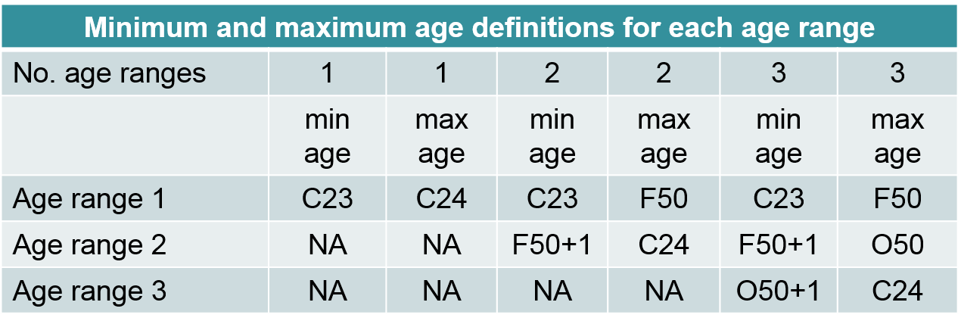
NT/TB Input Worksheets
Age Range Definition - Cells A48:F51
At times, the qualification standards will differ by age range
No. of age ranges = 2 (cell F49=2)
  Cells J48:O51 are unhidden
No. of age ranges = 3 (cell F49=3)
Cells J48:O51, S48:X51 are unhidden

Slide 16
NT/TB Input Worksheets
Tobacco Definition - Cells A54:H62
This section provides the tobacco definition used in the program
Data is collected for a future upgrade only
  Information is not reflected in current calculation (i.e. – does not impact results)
No. of tobacco definition age ranges
  Choices are 1 or the value in cell F49 (overall program no. of age ranges)
  If tobacco definition is same across all age ranges, insert 1 in cell F55
    Definition needs to be input only once even if multiple age ranges used in other criteria
Tobacco definition has two aspects
  Usage definition: choices ={No nicotine usage, No nicotine except minor cigars, No cigarette usage}
  Period since quit smoking: Choices are most recent {1, 2, 3, 4, 5, 6+} years
Definitions may vary by risk class
Definitions are inputted on non-tobacco worksheet only

Slide 17
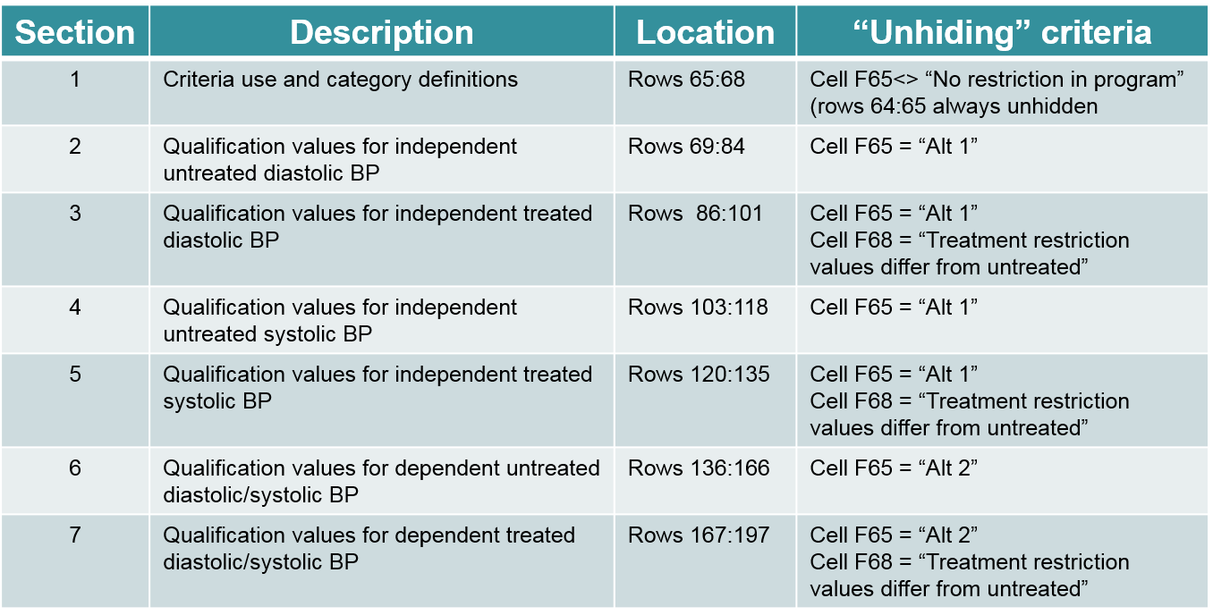
NT/TB Input Worksheets
Blood Pressure Criterion - Rows 64:196
Seven sections within each age range
The “unhiding” criteria for each section shown in the above table indicate the locations in age range 1
Criteria for age ranges 2 and 3 are in similar rows in their respective columns

Slide 18
NT/TB Input Worksheets
Blood Pressure Criterion - Cells A64:H68, Section 1 #1
Restriction Criteria Type: (input: cell F65, description: cell C65)
  No restriction in program – Blood pressure not used as preferred criterion
  Alt 1 – separate (and independent) diastolic and systolic blood pressure qualification values
  Alt 2 (DBP/SBP combo) – coordinated diastolic and systolic blood pressure qualification values
Formula Method: (input: cell F66)
  Knock-out – blood pressure impacts risk class qualification on a knock-out basis
    If overall program is debit-credit, this criterion can still have a knock-out impact
  Debit-credit – blood pressure impacts risk class qualification on a debit-credit basis
No of Age Ranges: (input: cell F67)
  Does criterion vary by age, and if so how many sets are used (1 or value in cell F49)

Slide 19
NT/TB Input Worksheets
Blood Pressure Criterion - Cells A64:H68, Section 1 #2
Treated BP qualification: (input: cell F68)
  Treatment disallowed – Applicants being treated for BP qualify for only standard/residual risk class
  No treatment restriction differences – Whether an applicant is being treated or not is ignored in the qualification requirement for the risk class, using the same min and max BP qualification values
  Treatment restriction values differ from untreated – Applicants treated for BP can qualify for various preferred classes, but with different qualification standards. Therefore, standards for treated applicants need to be inputted.

Slide 20
NT/TB Input Worksheets
Blood Pressure Qualification Values - Sections 2 – 7 #1
Section 2 (rows 69:84)
  Program minimum value (>=) – Defines the minimum diastolic blood pressure need for an individual without other serious health issues to qualify as a standard (vs. substandard) risk
  Program maximum value (<=) – Defines the maximum diastolic blood pressure need for an individual without other serious health issues to qualify as a standard (vs. substandard) risk
  Comments
    This is designed to indicate whether the std/sub-std underwriting is liberal or conservative
    Underwriters may be able to assist in deciding on reasonable numbers
    Numbers may not always be directly specified or exactly known
      Make best estimate; industry standard values are provided in cells E70:E71
    “Table” minimum and maximum values are the extreme values reflected in this algorithm. Underlying assumptions beyond these boundaries do not impact the calculations.
    “Standard” values produce overall program mortality of 100%, using other min/max will impact program’s overall mortality (creating total portfolio mortality > or < than 100%)
      Values are reasonable average industry values based on committee discussions

Slide 21
NT/TB Input Worksheets
Blood Pressure Qualification Values - Sections 2 – 7 #2
Section 2 continued
Risk Class (cells A72:A84) – Defines the risk value to which that row’s value is assigned
  Pick from a drop-down box of risk class names as defined in cells C28:C33 (NT) and D28:D33 (TB)
  Hidden if blood pressure formula method = Debit-Credit (cell F66)
  The same risk class can be used in more than one row (e.g.- J/U curve standards)
DC Points (cells B72:B84) – Defines the number of D/C points assigned to the range defined in that row
  All integer, decimal and positive/negative numbers are acceptable
  Caution: Use of decimal numbers may overflow calculation capacity, if too many number combinations (max of 500 combinations allowed in program)
    Error message will show up in cells E37:F43)
  Hidden if blood pressure formula method = Knock-out (cell F66), or if program formula method = Knock-out (cell B22)
Segment high value (cells C72:C84)
  Insert the maximum diastolic blood pressure value (upper bound) allowed for corresponding risk class/debit points.
  Implied lower bound of range is highest value of all range maximums less than this one plus the minimum incremental value (for BP, the incremental value is 1.0)
    Lower bound for lowest range is program minimum value defined in cell C70

Slide 22
NT/TB Input Worksheets
Blood Pressure Qualification Values - Sections 2 – 7 #3
Sections 3 – 7
  Consistent with descriptions for section 2: except
    Columns for both systolic and diastolic maximum qualification values need to be input in each row
    There are also columns for SBP and DBP minimums
      Program limit minimum/maximum values in cells C141:F141 (untreated) and C172:F172 (treated) are still needed
      Specific risk class qualification min values are calculated and therefore columns C and E inputs are not used/needed and can be ignored.

Slide 23
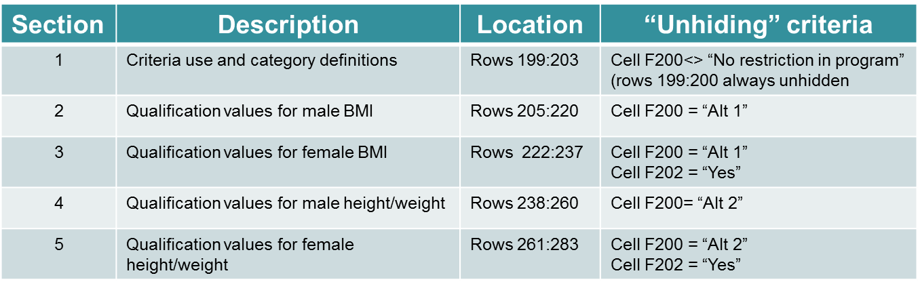
NT/TB Input Worksheets
Build Criterion - Rows 199:283
Five sections within each age range

Slide 24
NT/TB Input Worksheets
Build Criterion - Cells A199:F203
Section 1
    Restriction Criteria Type: (input: cell F200, description: cell C200)
    No restriction in program – Build is not used as preferred criterion
    Alt 1 (BMI) – restriction values are in the form of body mass index (BMI)
    Alt 2 (Height-Weight) – restriction values are in the form of height-weight measures
  Formula Method: (input: cell F201)
    Similar description as used for Blood Pressure
  Values differ by gender?: (input cell F202)
      No – Inputted male values are also used for females, no need to input female values
      Yes – Input separate female values
      Note: “Yes” should always be used for Restriction Criteria Type: Alt 2 (Height-weight). (cell F200)
        Representative heights used in the height-weight values are different for males and females
  No of Age Ranges: (input: cell F67)
    Similar description as used for Blood Pressure

Slide 25
NT/TB Input Worksheets
Build Qualification Values - Sections 2 – 5 #1
Section 2 (rows 205:220)
  Program minimum value (>=) – Comments similar to Blood Pressure (cell C206)
  Program maximum value (<=) – Comments similar to Blood Pressure (cell C207)
  Risk Class (cells A208:A220) – Defines the risk value to which that row’s value is assigned
    Comments similar to Blood Pressure
  DC Points (cells B208:B220) – Defines the number of D/C points assigned to the range defined in that row
    Comments similar to Blood Pressure
  Segment high value (cells C208:C220)
    Comments similar to Blood Pressure
    BMI section comments similar to Blood Pressure

Slide 26
NT/TB Input Worksheets
Build Qualification Values - Sections 2 – 5 #2
Sections 3 – 5 (rows 222:283)
  Comments same as for section 2; except
  Sections 4 – 5 (Height / Weight)
    Height-weight sections 4 – 5 have three sets of “segment high value” to insert maximum weights
      Males, one for each of heights 5’6”, 5’10” and 6’2”.
      Females, one for each of heights 5’2”, 5’6” and 5’10””.
    If this alternative is used, ensure that cell F202 (Values differ by gender) = “Yes”

Slide 27
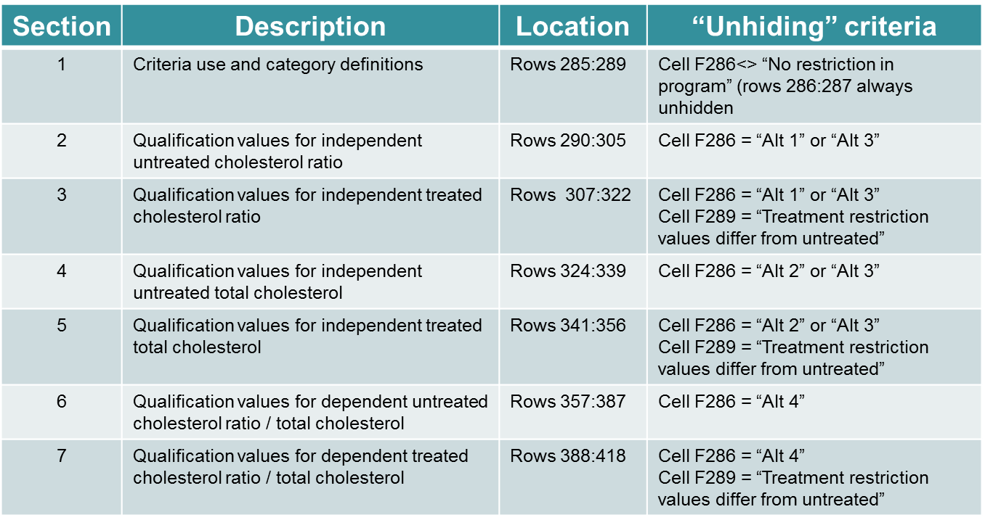
NT/TB Input Worksheets
Cholesterol Criterion - Rows 285:418
Seven sections within each age range

Slide 28
NT/TB Input Worksheets
Cholesterol Criterion
Section 1 (rows 285:289)
  Comments same as Blood Pressure section 1; except
  Restriction Criteria Type: (input: cell F86, description: cell C286) – Define qualification structure used
    No restriction in program – Cholesterol not used as preferred criterion
    Alt 1 (Chol Ratio) – Cholesterol ratio qualification values only
    Alt 2 (Total Chol) – Total cholesterol qualification values only
    Alt 3 (Independ CR & TC) – Cholesterol ratio and total cholesterol independent qualification values
    Alt 4 (Combo CR & TC) – Cholesterol ratio and total cholesterol coordinated qualification values
Sections 2 – 7 (rows 290:418)
  Comments same as Blood Pressure sections 2 - 7

Slide 29
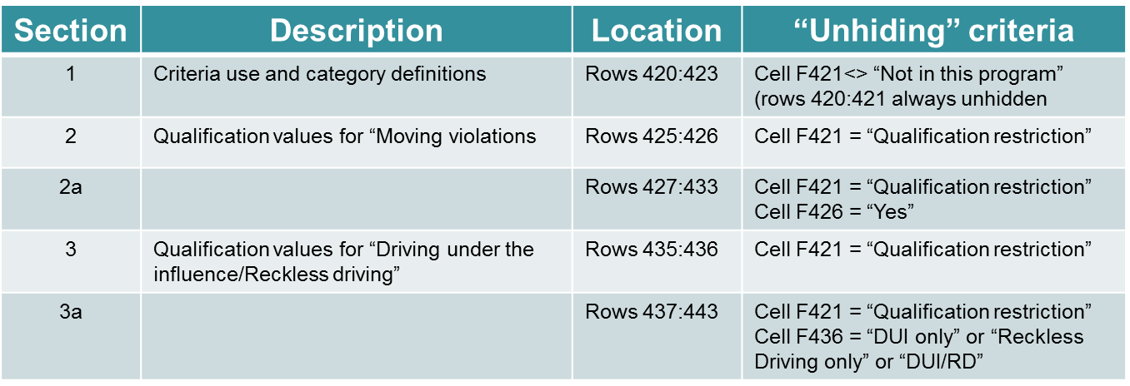
NT/TB Input Worksheets
Driving Record – Rows 420:443
Three sections within each age range

Slide 30
“Input – {NT/TB}” Worksheets
Driving Record Qualification Values - Sections 2 – 3 #1
Section 2 (rows 425:433)
  Risk Class (cells A427:A433) – Defines the risk value to which that row’s value is assigned, if knock-out
    Similar comments as in Blood Pressure section
  DC Points (cells B427:B433) – Defines the number of D/C points assigned to the range defined in that row, if debit-credit
    Similar comments as in Blood Pressure section
  Measure period (Yrs) (cells C427:C433) – Defines the number of most recent years in which the driving record is considered
    The drop-down list provides the number of years recognized in the program
  Max. no. of allowed events (cells D427:D433) – Defines the maximum number of events which do not disqualify the individual risk for the defined risk class
    Qualification wordings here can be misinterpreted. If the restriction is that 2 or more events will disqualify the risk for this category, then the maximum number of allowed events is one (1).
  Flat Extra Rating (cells E427:E433) – Indicates whether a “Flat Extra Rating” would disqualify a risk for this category

Slide 31
“Input – {NT/TB}” Worksheets
Driving Record Qualification Values - Sections 2 – 3 #2
Section 3 (rows 435:443)
  Comments are similar to those for section 2; except
  “Industry definition of std” (cells F437:G441)
    If the number of years reviewed is five (5) or less, the overall mortality will be increased as this is more liberal than the industry standard implied in the baseline assumptions. Similarly, if six – nine years are reviewed, allowing any events will increase the overall mortality. For 10+ years, two or more allowed events will have a similar impact.

Slide 32
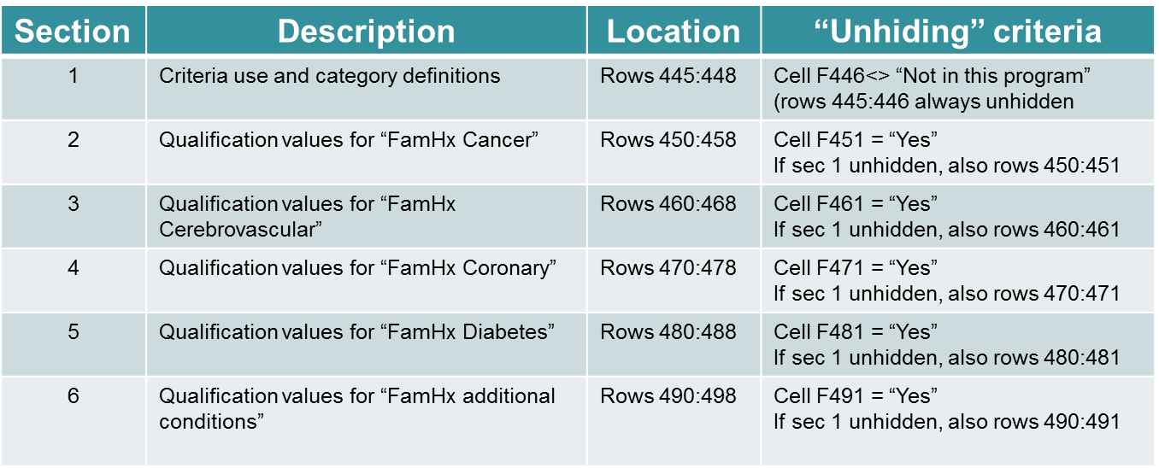
NT/TB Input Worksheets
Family Medical Hx – Rows 445:498
Six sections within each age range

Slide 33
“Input – {NT/TB}” Worksheets
“Family Medical Hx” Qualification Values - Sections 2 – 6 #1
Section 2 (rows 450:458)
  Risk Class (cells A452:A458) – Defines the risk value to which that row’s value is assigned, if knock-out
    Similar comments as in Blood Pressure section
  DC Points (cells B452:B458) – Defines the number of D/C points assigned to the range defined in that row, if debit-credit
    Similar comments as in Blood Pressure section
  Event definition (cells C452:C458) – Defines whether the restricting event is either death or “death or diagnosis”
  Family relationship (cells D452:D458) – Defines whether the family history of parents, siblings or other relatives is considered
  Max. no. of allowed events (cells E427:E433) – Defines the maximum number of events which do not disqualify the individual risk for the defined risk class
    Qualification wordings here can be misinterpreted. If the restriction is that 2 or more events will disqualify the risk for this category, then the maximum number of allowed events is one (1).
  Max age of family member (cells F453:F458) – For the event to be considered as a qualification value, defines the maximum age of the family member at the occurrence of the event

Slide 34
“Input – {NT/TB}” Worksheets
“Family Medical Hx” Qualification Values - Sections 2 – 6 #2
Sections 3 - 6 (rows 460:498)
  Comments are similar to those for section 2; except
  “FamHx additional conditions” (section 6: rows 490:498)
    “Max age of family member” is not included in the definition
    “Description” – Insert a description of additional family history conditions that have a reasonable amount of mortality predictive value
        “No. of other diseases” – Insert the number of other family history conditions used in the program qualifications. The program allows for up to two additional conditions.

Slide 35
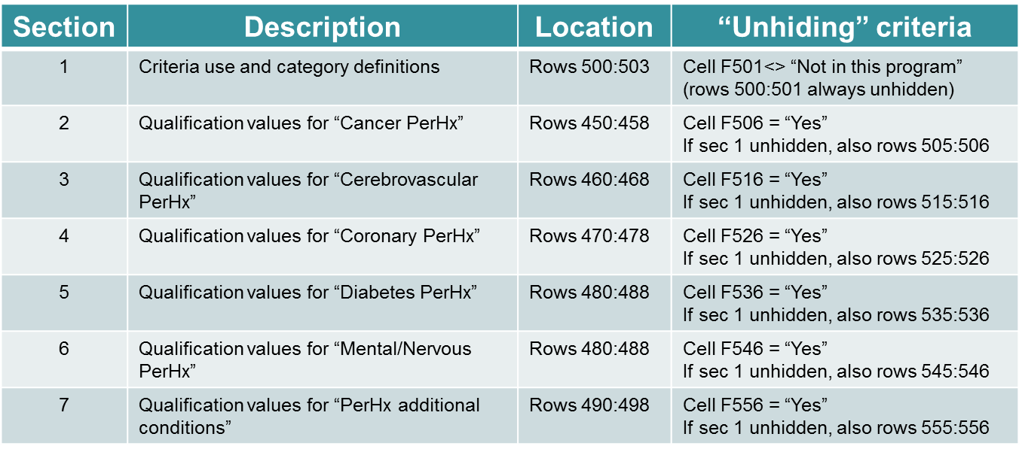
NT/TB Input Worksheets
Personal Medical Hx – Rows 500:563
Seven sections within each age range

Slide 36
“Input – {NT/TB}” Worksheets
“Personal Medical Hx” Qualification Values - Sections 2 – 7 #1
Section 2 (rows 505:513)
  Risk Class (cells A507:A513) – Defines the risk value to which that row’s value is assigned, if knock-out
    Similar comments as in Blood Pressure section
  DC Points (cells B507:B513) – Defines the number of D/C points assigned to the range defined in that row, if debit-credit
    Similar comments as in Blood Pressure section
  Flat Extra Rating (cells C507:C513) – Indicates whether a “Flat Extra Rating” would disqualify a risk for this category
Sections 3 - 7 (rows 515:563)
  Comments are similar to those for section 2; except
  “PerHx additional conditions” (section 7: rows 555:563)
    “Number of other diseases” – Insert the number of other personal history conditions used in the program qualifications. The program allows for up to two additional conditions.
    “Description” – Insert a description of additional personal history conditions that have a reasonable amount of mortality predictive value
    Only include conditions which have predictive mortality value, but would not already have been classified as “substandard” in the underwriting process

Slide 37
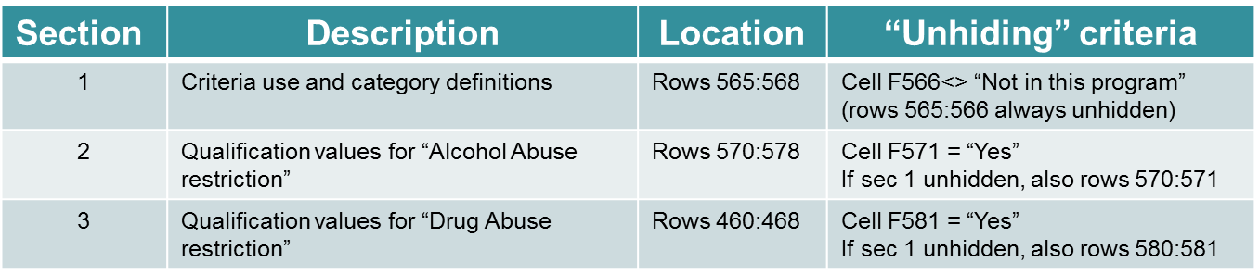
NT/TB Input Worksheets
Substance Abuse – Rows 565:588
Three sections within each age range

Slide 38
“Input – {NT/TB}” Worksheets
“Substance Abuse” Qualification Values - Sections 2 – 3
Section 2 (rows 570:578)
  Risk Class (cells A572:A578) – Defines the risk value to which that row’s value is assigned, if knock-out
    Similar comments as in Blood Pressure section
  DC Points (cells B572:B578) – Defines the number of D/C points assigned to the range defined in that row, if debit-credit
    Similar comments as in Blood Pressure section
  Measure period (cells C572:C578) – Indicates the time period over which the individual’s driving record is considered
    For alcohol abuse (cells E572:F575), a measure period of 7 years is considered to be standard. A shorter time period will increase the mortality of the overall portfolio.
Section 3 (rows 580:588)
  Comments are similar to those above for section 2; except
  For drug abuse (cells E582:F585), a measure period of 5 years is considered to be standard. A shorter time period will increase the mortality of the overall portfolio

Slide 39
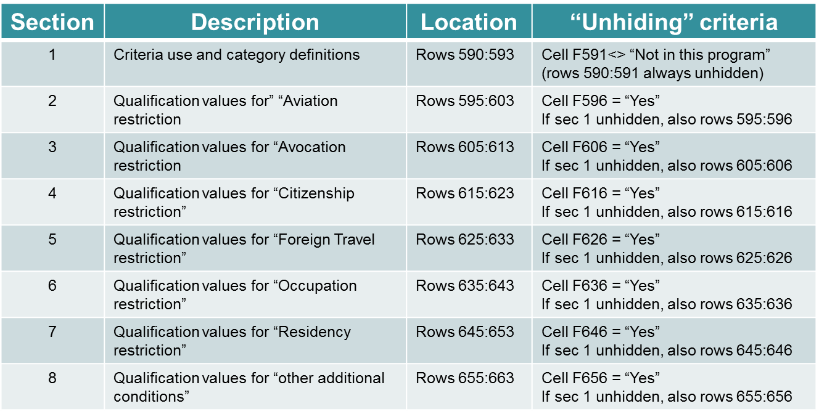
NT/TB Input Worksheets
Other Restrictions – Rows 590:663
Eight sections within each age range

Slide 40
“Input – {NT/TB}” Worksheets
“Personal Medical Hx” Qualification Values - Sections 2 - 8
Section 2 (rows 595:603)
  Risk Class (cells A507:A513) – Defines the risk value to which that row’s value is assigned, if knock-out
    Similar comments as in Blood Pressure section
  DC Points (cells B507:B513) – Defines the number of D/C points assigned to the range defined in that row, if debit-credit
    Similar comments as in Blood Pressure section
  Restriction included? (cells C507:C513) – Indicates whether this category is used as a restriction to qualifying for the specified risk class
Sections 3 - 8 (rows 605:663)
  Comments are similar to those above for section 2; except
  “Other additional conditions” (section 8: rows 655:663)
    “No. of other restrictions” – Insert the number of other general conditions used in the program qualifications. The program allows for up to two additional conditions.
    “Description” – Insert a description of additional conditions that have a reasonable amount of mortality predictive value
    Only include conditions which have predictive mortality value, but would not already have been classified as “substandard” in the underwriting process

Slide 41
In Closing
This is a draft version of the instructions documentation.
Suggestions for clarifying or improving comments are welcome and appreciated. Send any suggestions to Jack Luff, Society of Actuaries, at the email address: jluff@soa.org.

